Slide 1
Predicting Potato Yield Using Machine Learning
BY GROUP 3

Slide 2
Machine Learning Goal
ML Problem: How best can the yield of potatoes (tons per hectare) be predicted based on field characteristics?
Supervised ML: Regression
The target feature (potato yield) is a continuous variable.
Data set
https://dataverse.harvard.edu/file.xhtml?fileId=10850227&version=3.0
Target: Yield tons per hectare
Features: soil type, variety, planting and harvest dates, irrigation, and fertilizer use.

Slide 3
Data set description
Feature Name | Description | Data type
Location | Field Location | object
year | Year of cultivation | int64
variety | Potato variety | object
Planting date | Date of planting | int64
Harvest date | Date of harvesting | int64
Soil type | Type of Soil | object
Fertilizer Applied | Amount of fertilizer applied | Float64
Irrigation | Whether irrigation was used | 0bject
Yield | Potato yield | Float64

Slide 4
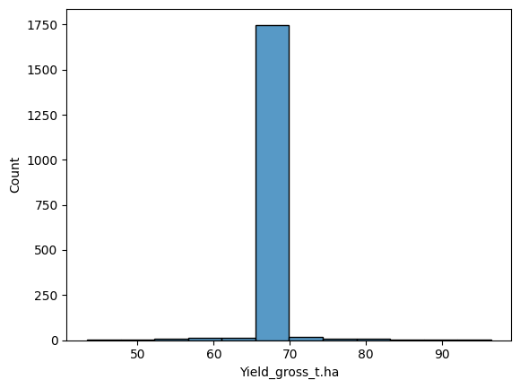
Histogram of potato yield (Univariate Analysis)
The yield distribution is highly concentrated around 70 t/ha, indicating consistent performance across plots with few outliers and minimal variation in productivity.

Slide 5
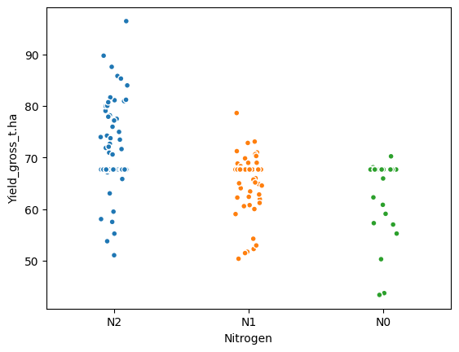
Stripplot of Potato vield vs of Fertlizer applied
Yield increases progressively with higher nitrogen levels, showing that nitrogen application has a strong positive influence on crop productivity.

Slide 6
Data Pre-processing
Handled all missing values.
Encoded categorical variables and scaled numerical features.
Train-test split
X train= 1368
y train= 1368
X test = 456
y test = 456

